Slide 1
Project meeting (2016-11-14) - DVA313

Slide 2
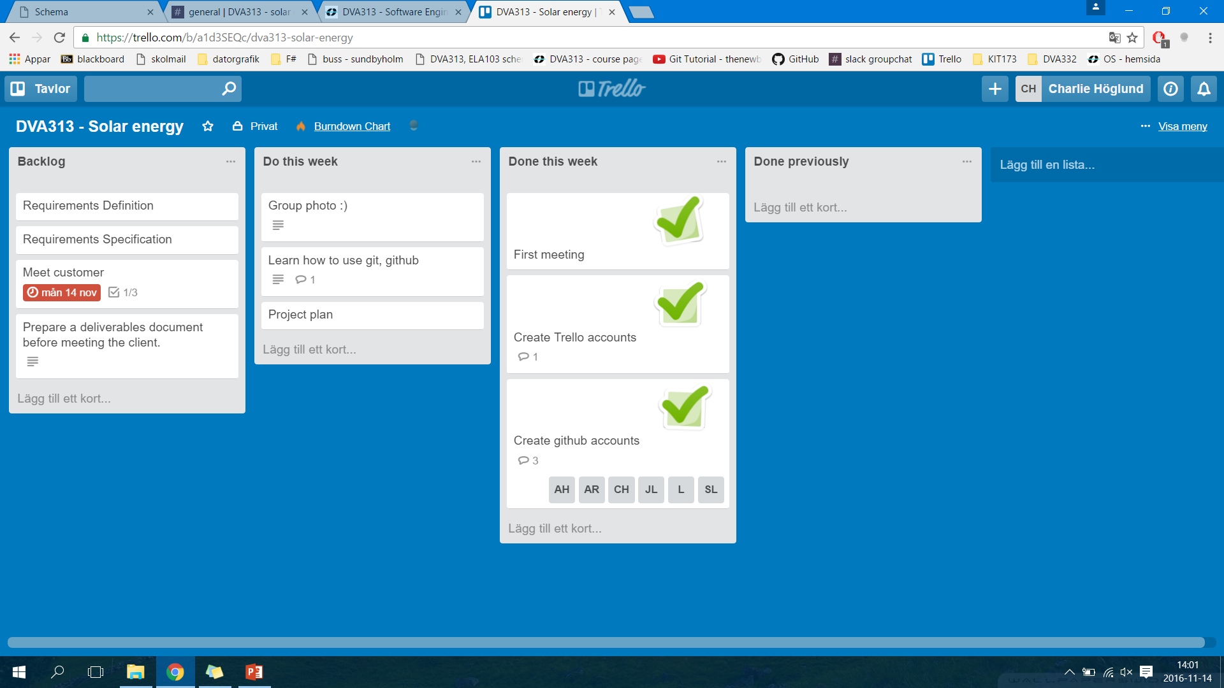
Trello board – Week 45 (previous)
Outcomes:
Finished the first project meeting, created trello and github accounts
Didn’t take the group photo, continuing to learn git/github (the ones who need it), continuing to work with the project plan

Slide 3
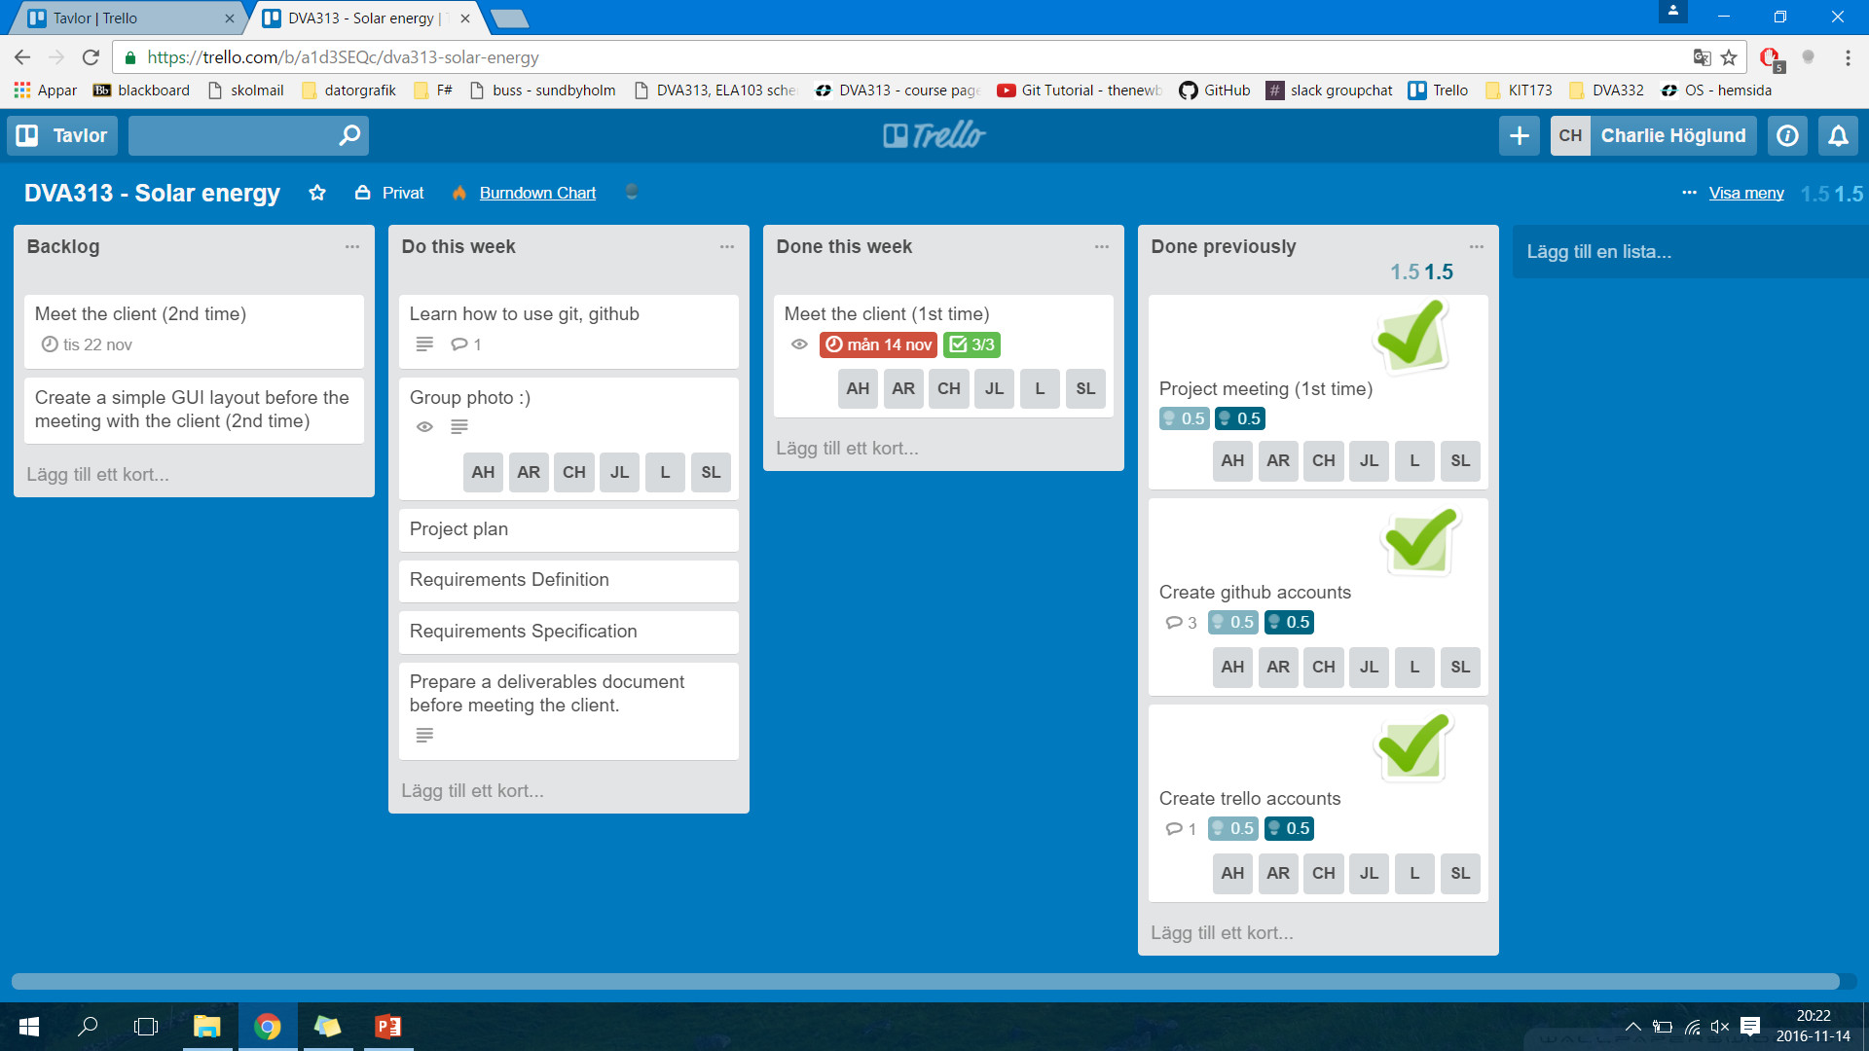
Trello board – Week 46 (now)
OBS. This trello board might change during this week (i.e. we will fill the backlog with more tasks etcetera)

Slide 4
Any obstacles, risks or issues that have been identified
We had a phone meeting with the client (2016-11-14) because he got sick
We have arranged a new physical meeting during next week (2016-11-22) with the client. Then the client will try to explain the given Excel files in more detail (i.e. we have had issues trying to understand all of the economics and math contained in those files)

Slide 5
Worked hours for each member, for each past week and accumulated so far
Approximately 20 hours/person last week

